Slide 1

Welcome the Protocol Presentation
Presented by:
Mohammad Saydul Hoque
Master of Public Health
Department of Public Health
North East University Bangladesh

Slide 2
“Knowledge and practice of Newly Married Couple regarding family planning method in Sylhet”.
Title-

Slide 3
Introduction
A newly married is a person who's recently gotten married and time limit with one year is considered. Most of the couple known a little bit on family planning method but they don`t know about all modern family planning method (merits & demerits), that`s why due to knowledge gap they were not able to practice in their conjugal life. Moreover access to information is the barrier & also the commodities un-availability within hand in the factor.
Most of the couple feel shame to discuss with others about family planning knowledge and practice and how he or she adopt, that`s why unwanted pregnancy, low birth weight baby, child mortality, malnutrition is going on.

Slide 4
Problem statement:
According to BDHS-2018, In Sylhet, unmet need is 14% whereas nationally 12%, TFR is 2.6 whereas nationally 2.3, but according to 4th HPNSP TFR need to decrease 2 by 2022, CPR need to increase 62% to 75% by 2022.
Modern method need to increase 44.8% to 60% by 2022 in Sylhet.
In the above statistics, newlywed are directly included in all the factors.
From this study- we want to find out what is the current knowledge and practice of newly married couple regarding family planning method in Sylhet

Slide 5
Rationale of the research
Why study is required-
(Considering Newly married couple)
1. To identify socio-demographic characteristics.
2.To identity current knowledge on FP method
3. To identity current practice on FP method.
4. To identify types of barrier
5. How to way improve.

Slide 6
Objectives:
General objectives:-
To assess way to increase knowledge and practice of Newly Married couple regarding family planning method in Sylhet.
Specific Objective:-
1. To identify socio-demographic characteristics.
2.To identity current knowledge on FP method
3. To identity current practice on FP method.

Slide 7
Methodology
Type of Study: Descriptive Cross-sectional.
Sampling Design- Random Sampling
Number of Upazila- 1. Golapgonj, & 2. Fenchugonj
Study period: Mar-2021 to June-2021

Slide 8
Independent Variables:
Socio demographic variables-
1. Age
2. Sex
3. Religion
5. Occupation
6. Educational qualification
7. Monthly income

Slide 9
Dependent variables- Knowledge & Practice about FP among newly married- -
1. To identify current knowledge on FP.
2. To identify current practice on FP
3. Source of FP commodities.
4. Interest to use FP
5. Access to identify FP commodities and gather knowledge
6. To identify alternate channel of distribution for FP commodities.

Slide 10
Ref. required (please input, how would I able to calculate ?)
Detail`s information-

Slide 11
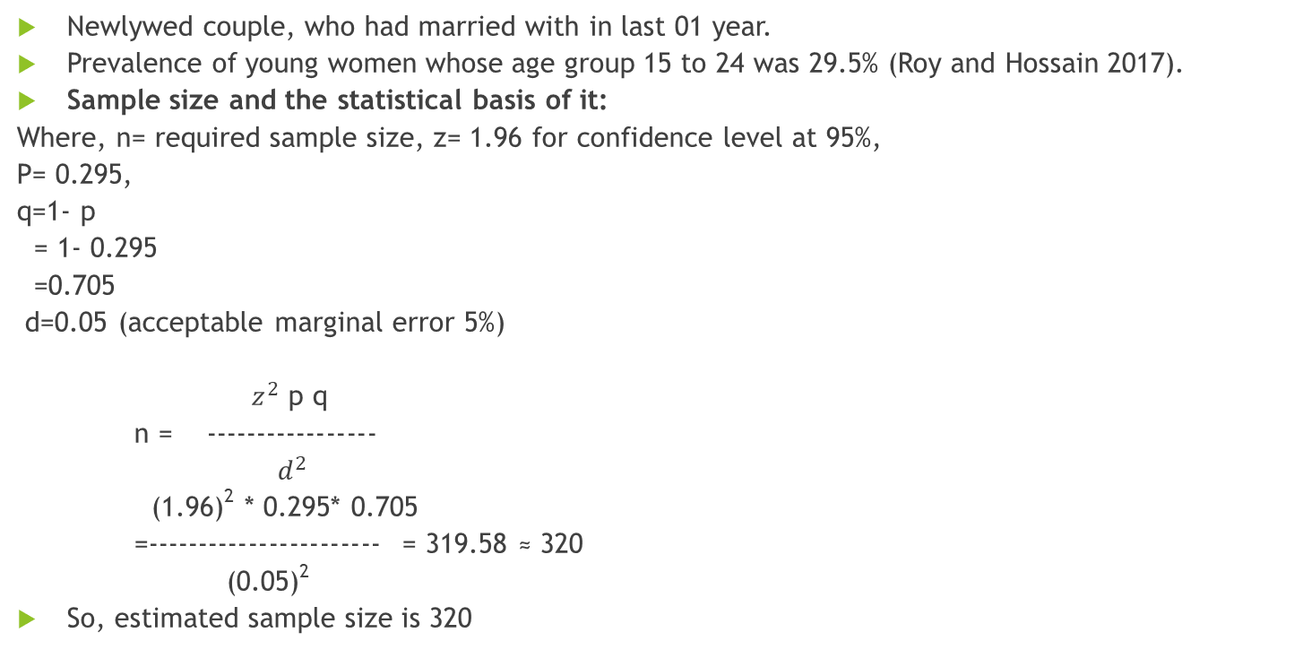
Study population:
Newlywed couple, who had married with in last 01 year.
Prevalence of young women whose age group 15 to 24 was 29.5% (Roy and Hossain 2017).
Sample size and the statistical basis of it:
Where, n= required sample size, z= 1.96 for confidence level at 95%,
P= 0.295,
q=1- p
= 1- 0.295
=0.705
d=0.05 (acceptable marginal error 5%)
$z^{2}$ p q
n = -----------------
$d^{2}$
(1.96)² * 0.295* 0.705
=----------------------- = 319.58 ≈ 320
(0.05)²
So, estimated sample size is 320

Slide 12
Sampling method:
Random Sampling

Slide 13
Criteria for sample selection
Inclusive criteria:-
1. Married within 1 year
2. Those who are willing to participate in the study.
Exclusive criteria:
1. Those who are not willing to participate in the study.
2. Data will not be collected from the person whose are over 1 year of married life.
3. Severely ill person.
4. Mentally disoriented people.

Slide 14
Method of data collection:
Face to face interview.
Permission and purpose of the study will be taken from respondents.
Respondents will be given full assurance on some ethical point of view that under no circumstances any part of the interview will not be disclosed to any unauthorized person.

Slide 15
Research question:
Types of Question- Semi Structured
Demographic & Socio-economic profile-
Name of the respondent-
Please Indicate your Gender-
A) Male B) Female
Please select the category that included in your Age-
A)18-27
B) 28-37
C) 38-47
D) 48 and over.
What is your Occupation-
A) Service Holder B) Entrepreneur C) Farmer D) Others

Slide 16
Demographic & Socio-economic profile-
Income Range-
A) 10000-20000 B)20001-30000 C) 30000 & Over
House hold condition-
A) Raw house B) Tin shed house C) Concrete.
Name of spouse-
--------------------------------------------
Date of Marriage-
---------------------------------------------

Slide 17
Knowledge & Practice
How many days later on you have to plan for child?
A) Immediately B) 1-3 years C) 4-5 years
Do you discussed with your partner how many children you want to in your conjugal life?
A)1-2 B) 3-4 C) 4 and over
Why required to delay first pregnancy until 20 years of age?
---------------------------------------------------------------------
Why required to avoid pregnancy after 35 years of age?
----------------------------------------------------------------------
Why birth spacing at least 3 years is required for healthy life?
-----------------------------------------------------------------------
Do you know what the benefit of to maintain first 1000 days for healthy and prosperous life of a children?
Yes B) No C) Unknown

Slide 18
Do you have any interest about FP method?
A) Yes B) No C) No comments.
What is benefit of use family planning method?
------------------------------------------------------------
What is the side effect of family planning method?
-------------------------------------------------------------
Know others people who have used FP method?
A) Yes B) No C) No comments
What is the preference of FP method?
-----------------------------------------------------
Do you use any FP modern method?
A) Yes B) No
Which method you currently use right now? (If yes)
A) Pill B) Condom C) Implant

Slide 19
What is benefit of Pill use?
-------------------------------------------
What is the benefit of condom use?
------------------------------------------------
What is the benefit of Implant use?
------------------------------------------------
Will you motive any newly married couple for modern FP method?
A)Yes B) No
What is the source of your FP commodities?
A) Pharmacy B) By Husband C) Others
Alternet channel of distribution of FP commodities?
A) Govt. source B) Private source C) Others
What is barrier of access to increase FP commodities?
---------------------------------------------------------------------
What is your expectation access to increase FP commodities?

Slide 20
Thanks for your best cooperation.

